Slide 1


System Analysis And Design (SAD)
Smita Bisht
Assistant Professor
School of Polytechnic

Slide 2
CASE TOOLS
Computer-Aided Software Engineering (CASE) It means, development and maintenance of software projects with help of various automated software tools.
The goal of introducing CASE tools is the reduction of the time and cost of software development and the enhancement of the quality of the systems developed.
CASE tools are set of software application programs, which are used to automate SDLC activities.

Slide 3
CASE tools are used by software project managers, analysts and engineers to develop software system.
There are number of CASE tools available to simplify various stages of Software Development Life Cycle such as Analysis tools, Design tools, Project management tools, Database Management tools, Documentation tools etc.
Use of CASE tools accelerates the development of project to produce desired result and helps to uncover flaws before moving ahead with next stage in software development.

Slide 4
Uses of CASE TOOLS
Improve the quality of the system.
Increase speed of design and development.
Ease and improve the testing process.
Improve integration of development activities.
Improve quality and completeness of documentation.
Improve management of the project.
Simplify program maintenance.
Promote reusability.

Slide 5
COMPONENTS OF CASE TOOLS
CASE Tools can be classified in the following three categories on the basis of SDLC activities they support:
1) Upper CASE.
2) Lower CASE.
3) Cross Life-Cycle CASE.

Slide 6
1) Upper CASE: This CASE tools designed to support the information planning and the project identification and selection, project initiation and planning, analysis and design phases of SDLC.
2) Lower CASE: This CASE tools designed to support the implementation and maintenance phases of the SDLC.
3) Cross Life-Cycle CASE: This CASE tools designed to support activities that occur multiple phases of SDLC.

Slide 7
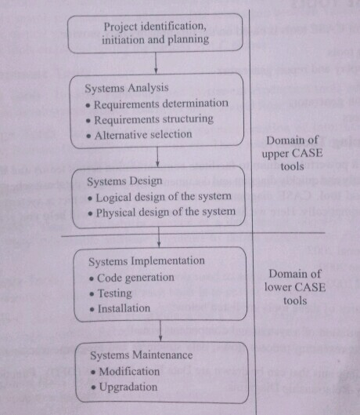

Slide 8
TYPES OF CASE TOOLS
The classification of CASE tools is based on the functionality they provide:-
1) Diagramming tools.
2) Computer Display and Report Generators.
3) Analysis Tools.
4) Documentation Generators.
5) Code Generators.

Slide 9
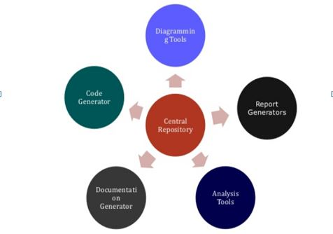
Types of CASE Tools

Slide 10
CASE DIAGRAMMING TOOLS
A good diagram is a powerful medium of facilitate communication across teams and the organization.
CASE diagramming tools enable us to depict a system and its various components diagrammatically.
Effective for representing process flows, data structures and program structures.
Several types of diagrams that can be drawn are Data Flow Diagram(DFD), Entity- Relationship Diagram(ER) etc.

Slide 11
REPORT GENERATORS TOOLS
This CASE tools help prototype how systems look and feel. It makes it easier for the systems analyst to identify data requirements and relationship.
It has two main purposes:
1) To create, modify and test prototype of computer display forms and reports.
2) To identify which data items to display or collect for each form or report.

Slide 12
CASE ANALYSIS TOOLS
Analysis CASE tools enable automatic checking for incomplete, inconsistent or incorrect specifications in diagrams, forms and reports.
Types of analyses vary depending on the organization’s development methodology and features of CASE environment.

Slide 13
DOCUMENTATION GENERATORS
This type of CASE Tool is used to produce technical and user documentation in standard formats
CODE GENERATORS
A code generators reads project meta-data ( for example database model) and writes well-featured source code to a specific set of design patterns.
Enable the automatic generation of program and data base definition code directly from the design documents, diagrams, forms, and reports.

Slide 14
ADVANTAGES OF CASE TOOLS
Easy revision of system descriptions and graphic representation.
Capability to change specifications and determine the impact of alternative features of system performance.
Capability to produce working source code for the application.
CASE tools also provide maintenance support as a result of storage of system specifications in a central information repository.

Slide 15
LIMITATIONS OF CASE TOOLS
Absence of standard levels of methodology support.
Limited functions supported.
Conflicting use of diagrams.
Human tasks remain critical.

